Slide 1
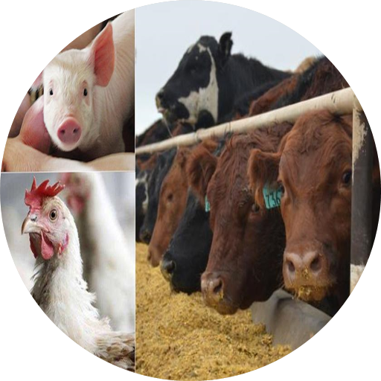
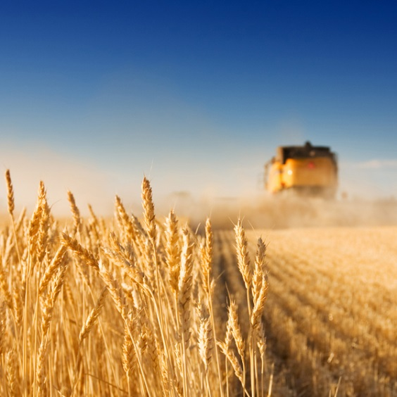
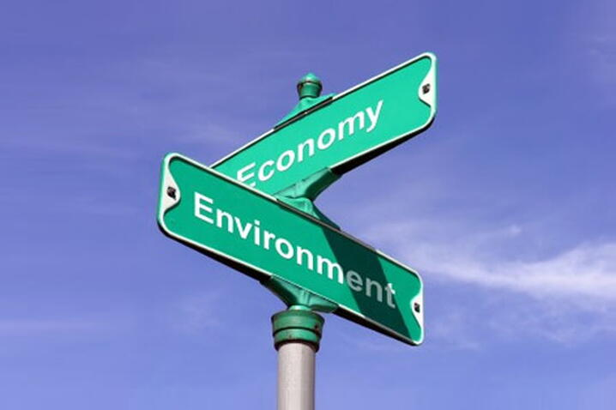
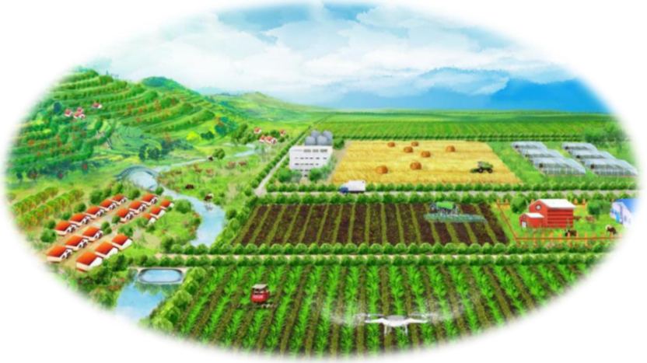
Integrated environmental-economic modelling of sustainable food systems in China
PhD candidate: Weitong Long
Supervisors: Dr. Xueqin Zhu, Dr. Hans-Peter Weikard, Prof. Oene Oenema, Dr. Yong Hou
Jul, 2023
1

Slide 2
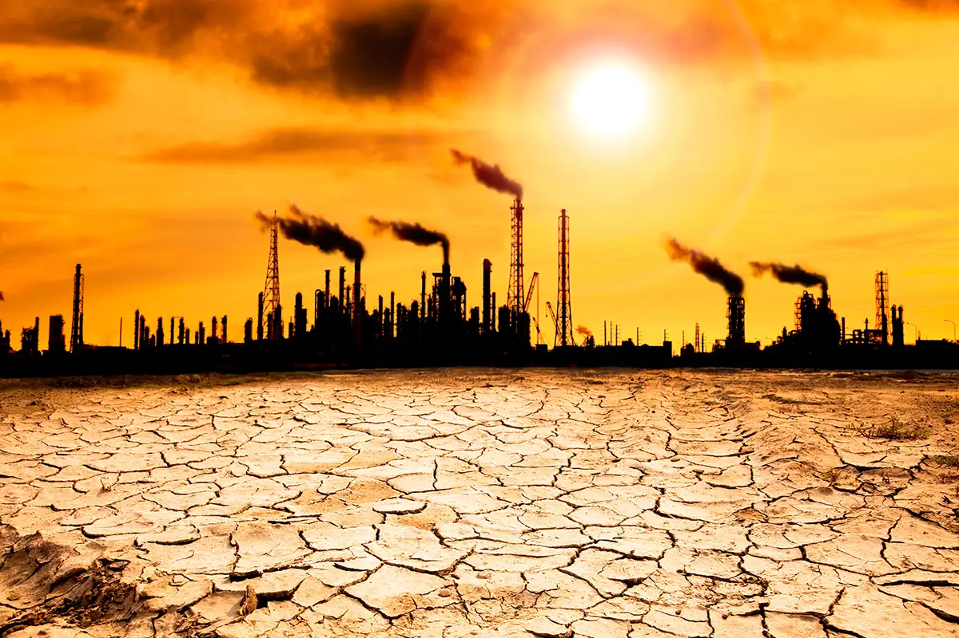

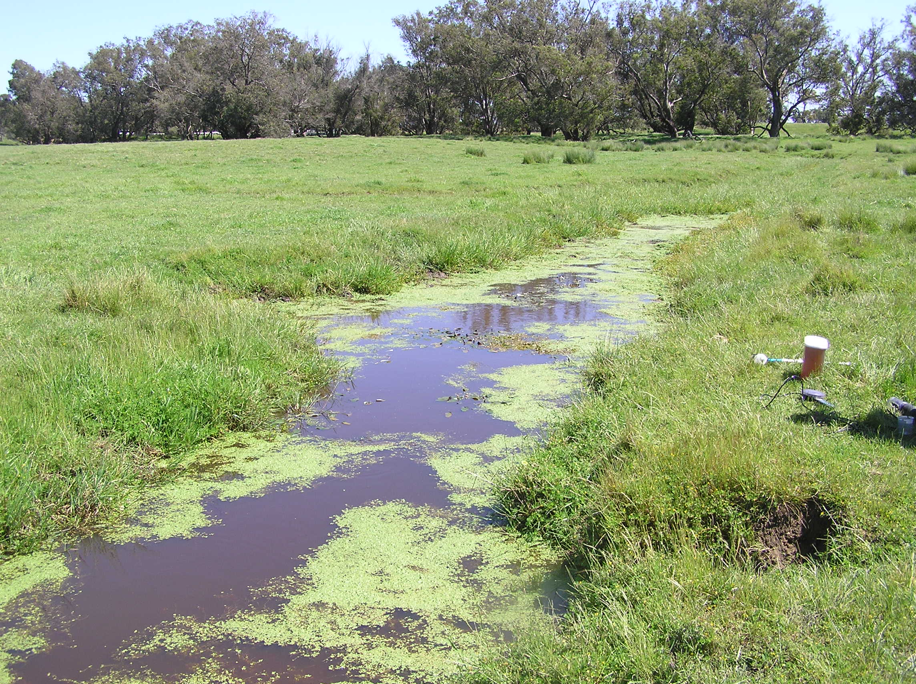
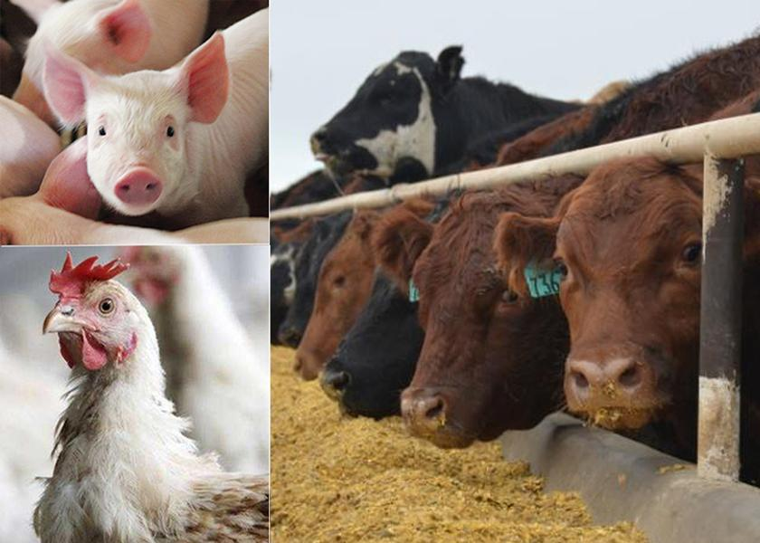
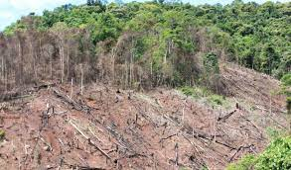
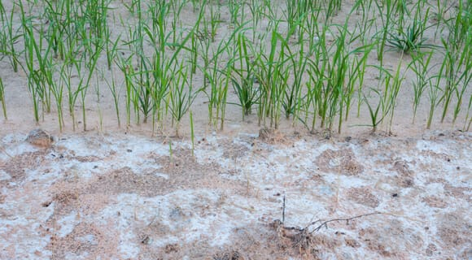
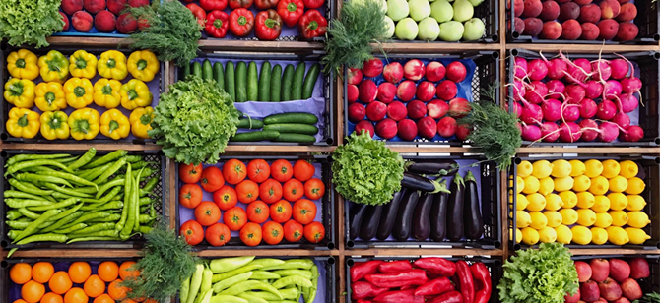
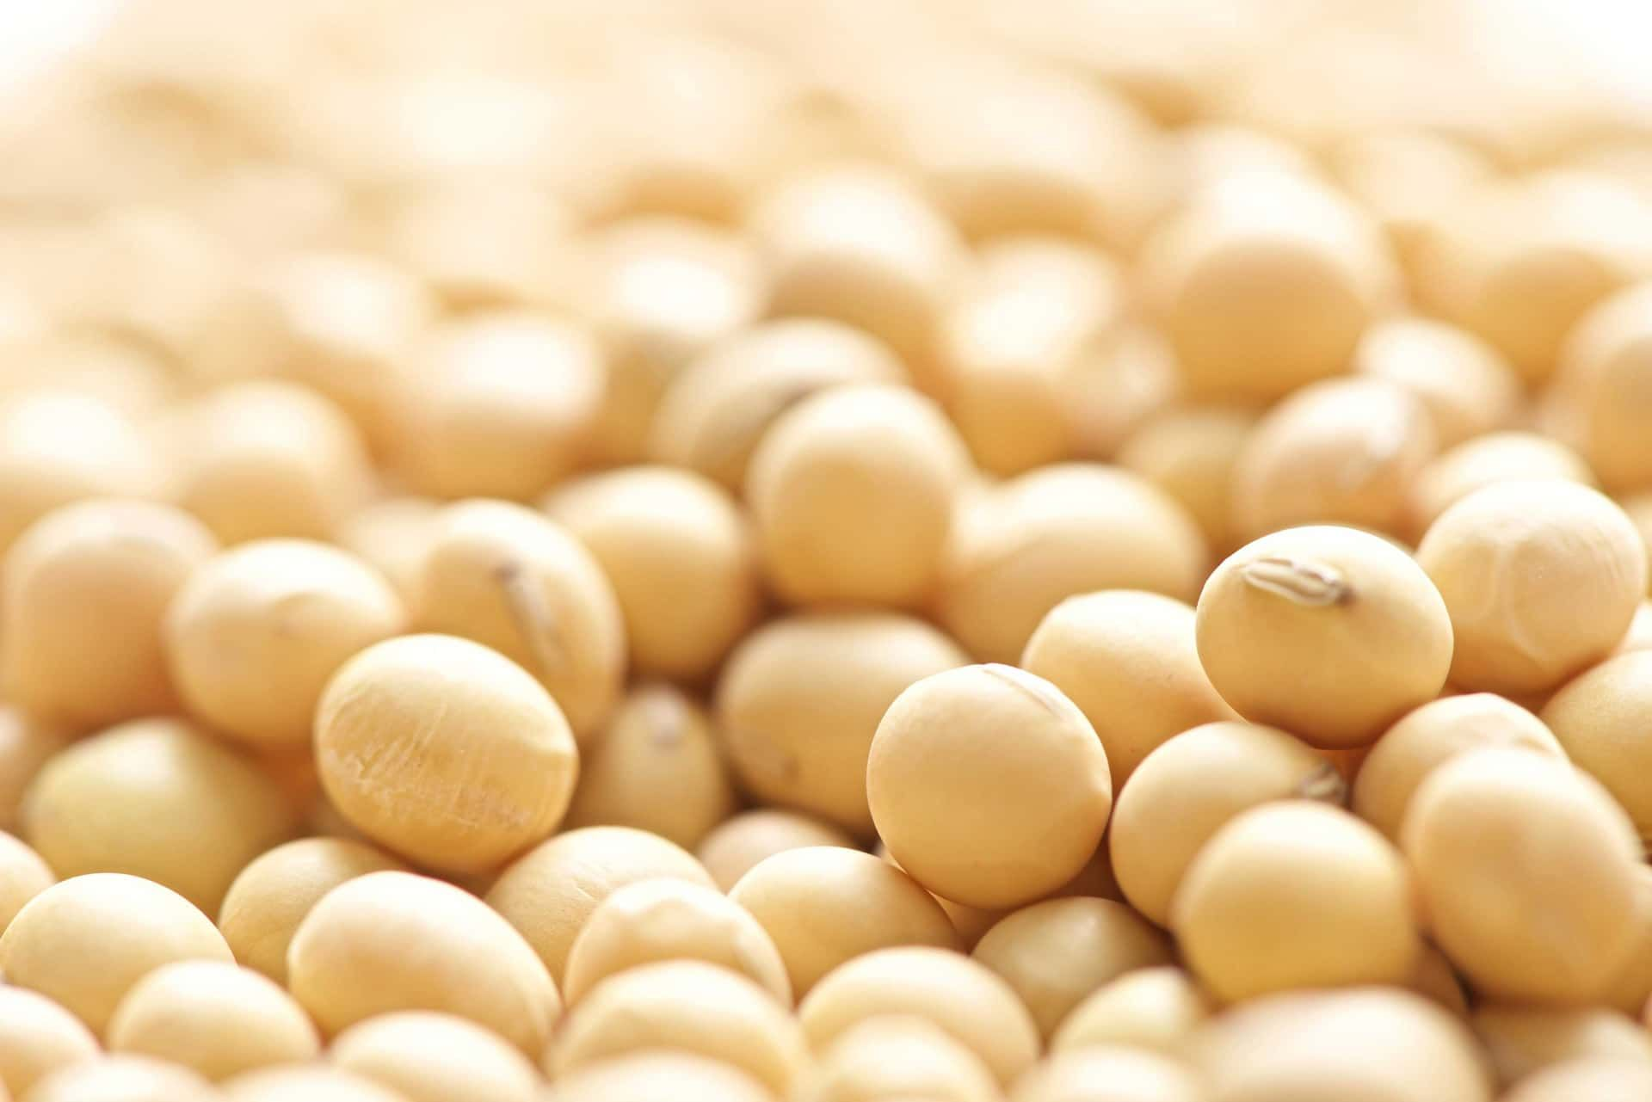

Environmental impacts of food production
Global warming
potential (GWP)
Acidification
potential (AP)
Eutrophication
potential (EP)
26%
80% (NH₃)
78%
Carbon dioxide (CO₂)
Methane (CH₄)
Nitrous oxide (N₂O）
Ammonia (NH₃）
Sulphur dioxide (SO₂)
Nitrogen oxides (NO_{x})
Nitrogen (N)
Phosphorus (P)
Ammonia (NH₃）
Land use
Soil quality
Erosion
Pollution
Salinisation
Deforestation
Landscape
Biodiversity
Food production
Water use
Green water
Blue water
(Herrero, M. et al., 2016, NCC; Uwizeye, A. et al., 2020, NF; Steinfeld, H., et al., 2006, FAO)

Slide 3
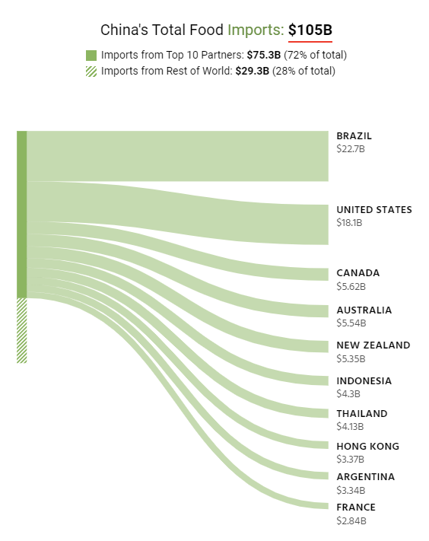
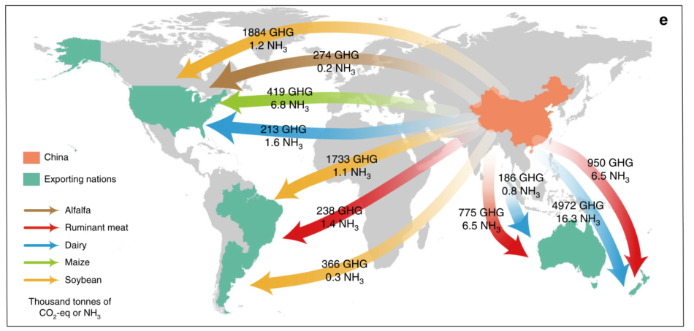
The global impacts of imported ruminant meat and milk to China
(Observatory of Economic Complexity, 2017)
(Du, Y., et al., NC, 2017)

Slide 4



Emission mitigation options
Dietary structure changes
More plant-based food
Production technology improvements
Less emission-intensive production technology
Policy instruments
Meat tax
Less food waste
Manure subsidy
Emission restriction
(Frank, S. et al., 2018, NC; Bai, Z. et al., 2014, EST; Hou, Y. et al., 2017, EST)

Slide 5





Research gap
Emission mitigation
options
A certain country/sector/
emission
Interactions and trade-offs between countries, sectors, and emissions
Other
countries/sectors/
emissions
Capital
Labour
Land

Slide 6
Objective and research questions
Objective:
To analyse the impacts of emission mitigation measures and policy on food production, consumption, trade, and emissions for China and its main food and feed trading partners.
Research questions:
What are the environmental and economic impacts of various options for adjustments in the food system in China?
What are the 'spillover impacts' on China’s trading partners under the adjustments?

Slide 7
Modelling framework

Slide 8
Modelling framework
Model type: Welfare format of static applied general equilibrium (AGE) model of the global economy
Data source:
Global Trade Analysis Project (GTAP) database version 10
Region- and sector-specific environmental impact database
Base year: 2014

Slide 9
Regions and sectors
Regions: China and its main food and feed trading partners (MTP, including Brazil, the United States, and Canada)
Sectors:
4 crop sectors (cereals, vegetables & fruits, soybean, other crops)
3 animal sectors (pig, poultry, other animals)
1 feed sector (compound feed)
5 other sectors (soy-based food (SBF), other food, nitrogen fertiliser, phosphorous fertiliser, non-food)

Slide 10
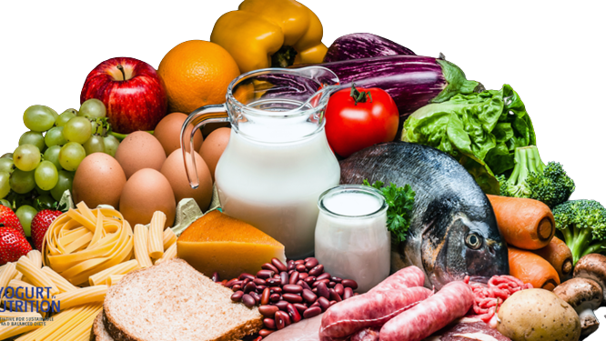




The welfare format of applied general equilibrium (AGE) model
Social welfare is the “collective utility” of all consumers.
(Pollak, R. et al., 1979, QJE)

Slide 11



Scenarios
Scenario 2 (S2)
A partial shift from pork to soy-based food
Increasing environmental concerns
Scenario 3 (S3)
Cleaner cereals production technology
Baseline
(S0)
Scenario 1
(S1)
Scenario 4 (S4)
Combination of dietary shift and cleaner cereals production
Scenario 5 (S5)
3% reduction
Emission restriction policy

Slide 12
Results part 1 based on S1:
Impacts of country-specific differences
in environmental concerns

Slide 13
MTP with higher environmental concerns has higher environmental quality
Environmental quality > 100
Lower emissions than S0
Environmental quality < 100
Higher emissions than S0
 |  | GWP | AP | EP
S0 | China | 100 | 100 | 100
 | MTP | 100 | 100 | 100
S1 | China | 98 | 79 | 62
 | MTP | 110 | 134 | 143
(1% of budget)
(2% of budget)

Slide 14
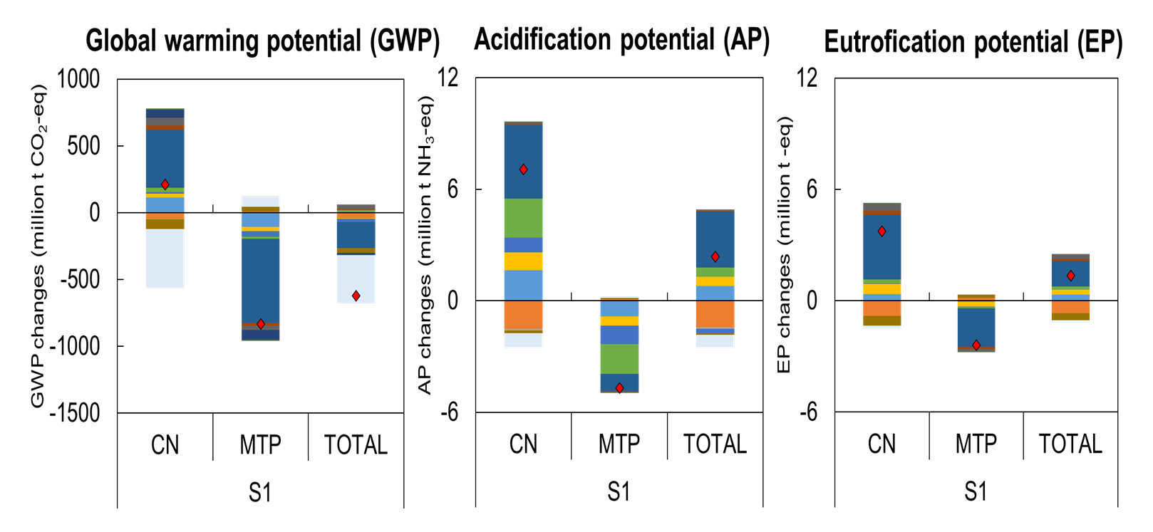
Emissions will leak from the MTP with higher environmental concerns to the China with lower environmental concerns

Slide 15
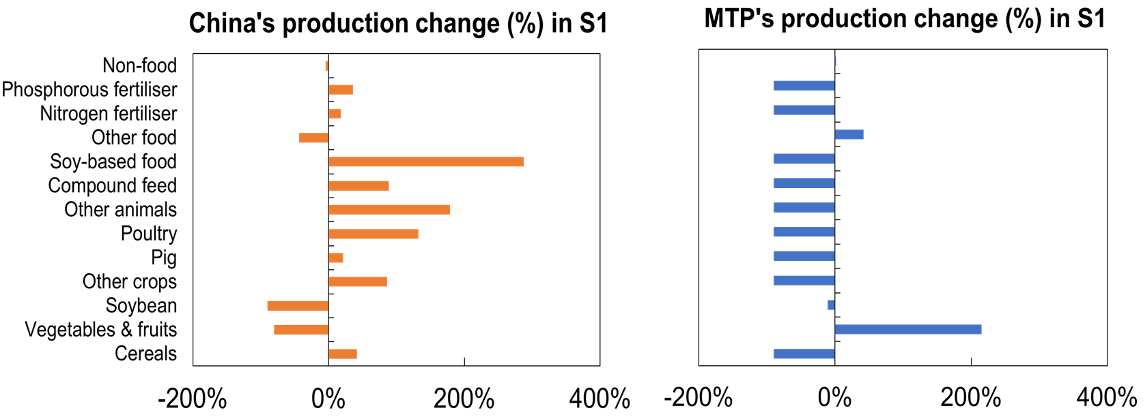
The production of goods with high emission intensities will take place in China with lower environmental concerns
MTP will reduce the production of goods with high emission intensities.

Slide 16
Results part 2 based on S2-S5:
Impacts of dietary structure, cleaner cereals production technology, and emission restriction policy

Slide 17
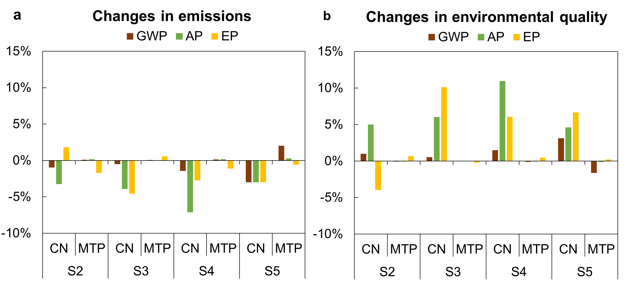
The environmental trade-offs caused by a dietary shift from pork to soy-based food
S1: Country-specific differences in environmental concerns
S2: Dietary structure change
S3: Cleaner cereals production technology
S4: Combination of dietary structure change and cleaner cereals production technology
S5: Emission restriction policy

Slide 18
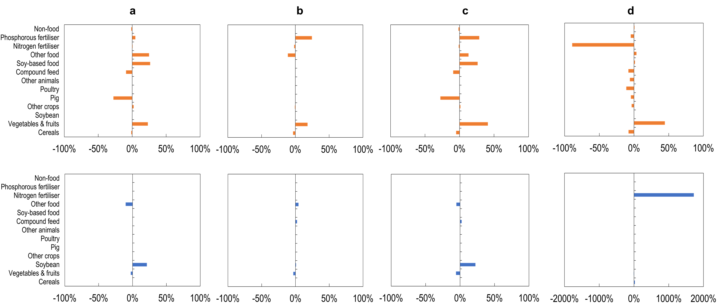
Changes in production for S2, S3, S4, and S5
S2
S3
S4
S5
CN
MTP
S1: Country-specific differences in environmental concerns
S2: Dietary structure change
S3: Cleaner cereals production technology
S4: Combination of dietary structure change and cleaner cereals production technology
S5: Emission restriction policy

Slide 19
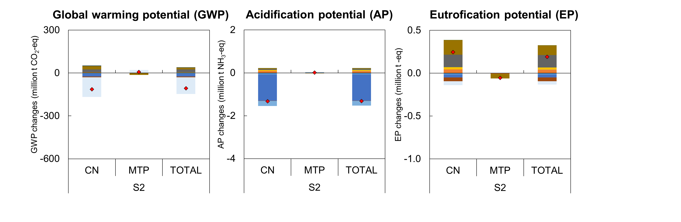
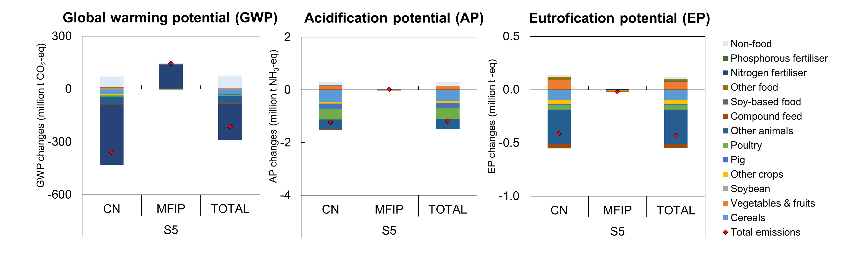
Changes in emissions for S2 (Dietary structure change)
Other food
Soy-based food
Non-food
Pig

Slide 20
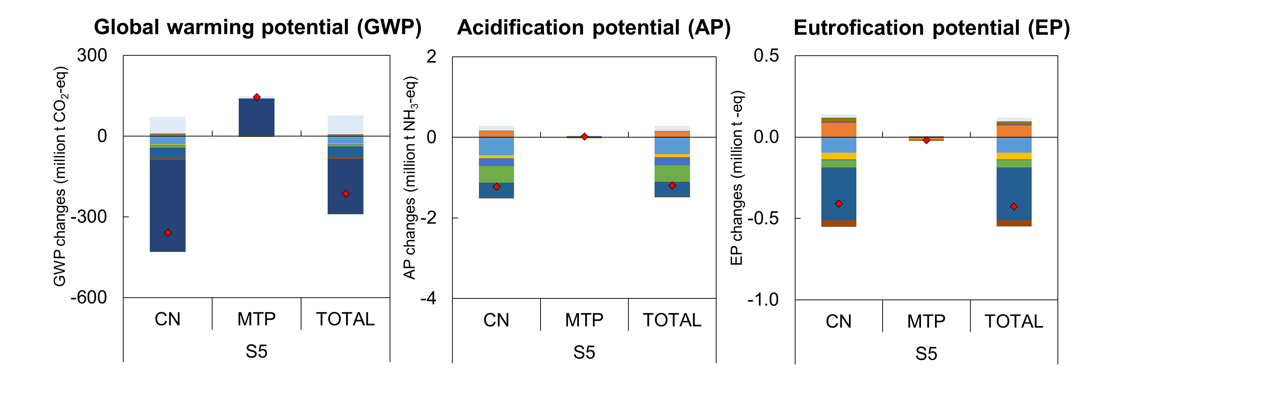
Changes in emissions for S5 (Emission restriction policy)
Cereals
Pig
Poultry
Nitrogen fertiliser
Other animals
Other animals

Slide 21
Conclusions
Only shifting the diet from pork to SBF is insufficient to reduce multiple environmental impacts (GWP: -1%; AP: -3%; EP: +2%).
Combining a dietary shift with a cleaner production technology will decrease all types of emissions (GWP: -1%; AP: -7%; EP: -3%).
Emission restrictions in China by 3% will decrease total emissions in China but cause emission leakages to its trading partners (GWP: +2%).
Using a social welfare perspective enables the identification of trade-offs between environmental and economic objectives.

Slide 22
Thank you!
Questions?
Contact me via
weitong.long@wur.nl

Slide 23
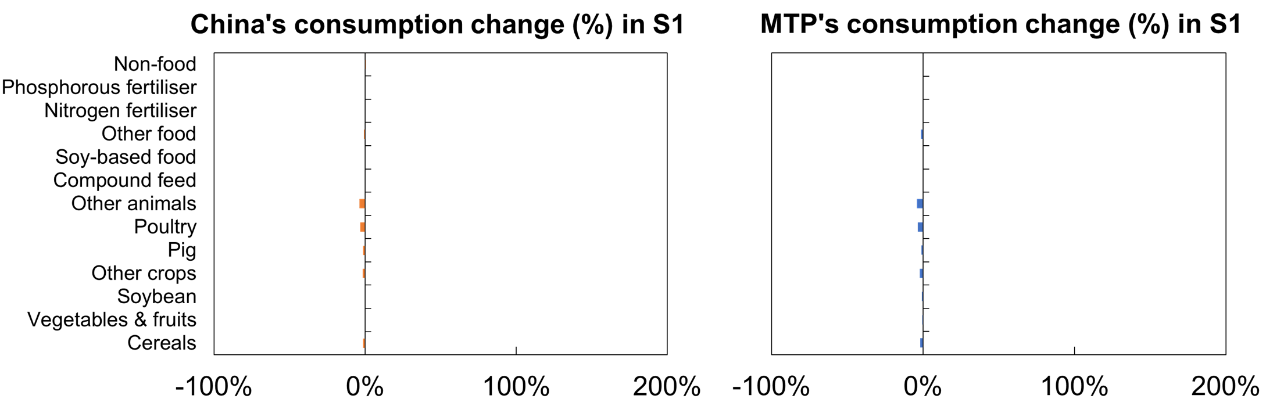
Changes in consumption for S1

Slide 24
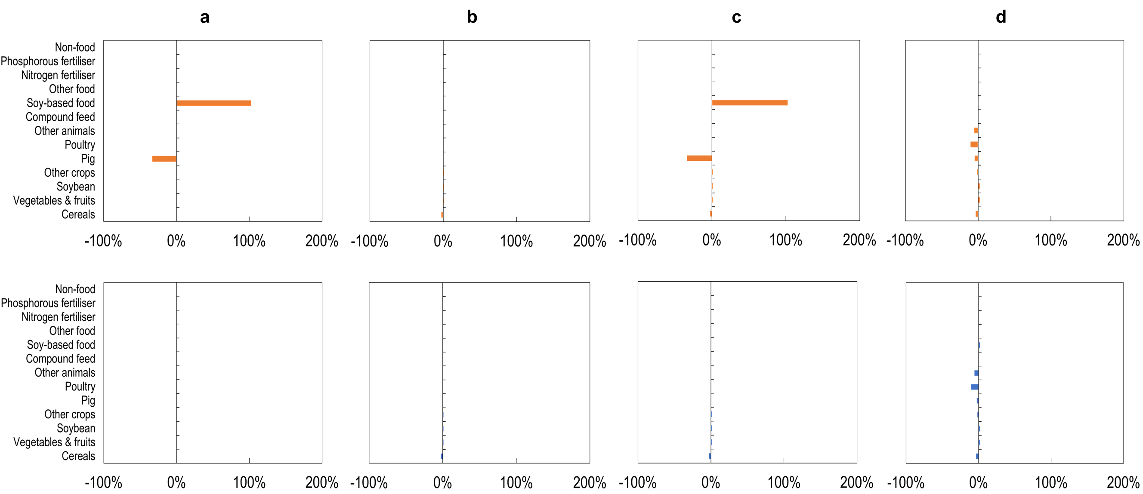
Changes in consumption for S2, S3, S4, and S5
S2
S3
S4
S5
CN
MTP
S1: Country-specific differences in environmental concerns
S2: Dietary structure change
S3: Cleaner cereals production technology
S4: Combination of dietary structure change and cleaner cereals production technology
S5: Emission restriction policy

Slide 25
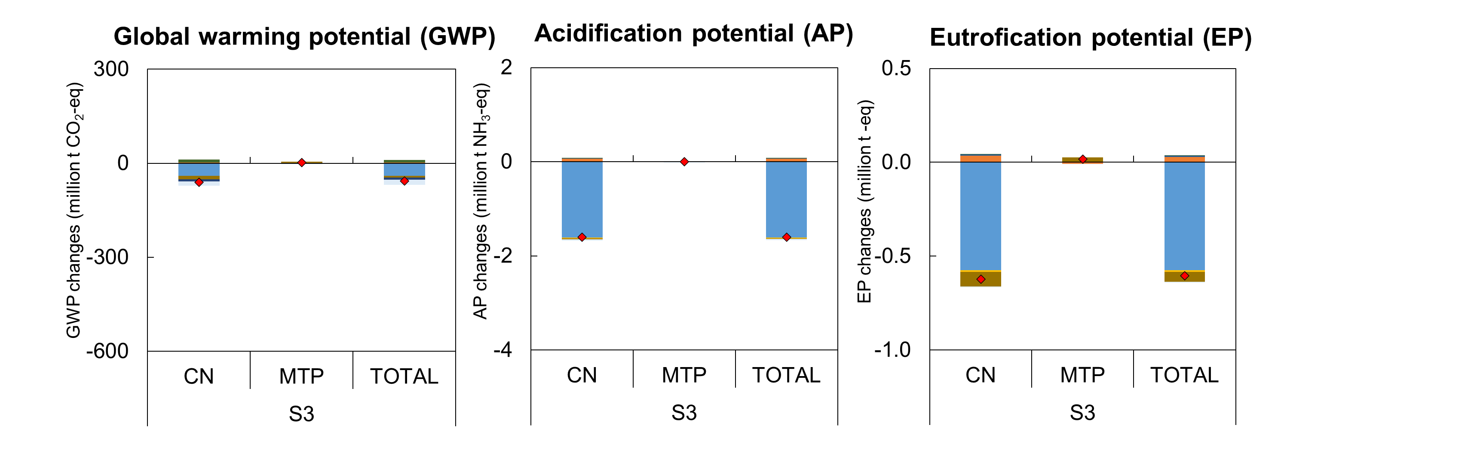
Changes in emissions for S3 (Cleaner cereals production technology)
Cereals
Cereals
Cereals

Slide 26
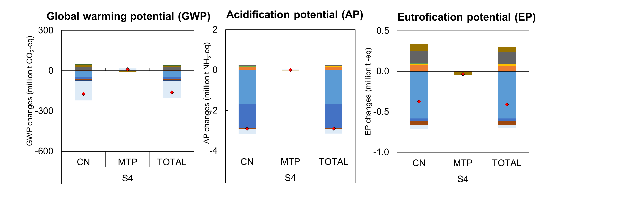
Changes in emissions for S4 (Combination of dietary structure change and cleaner cereals production technology)

Slide 27
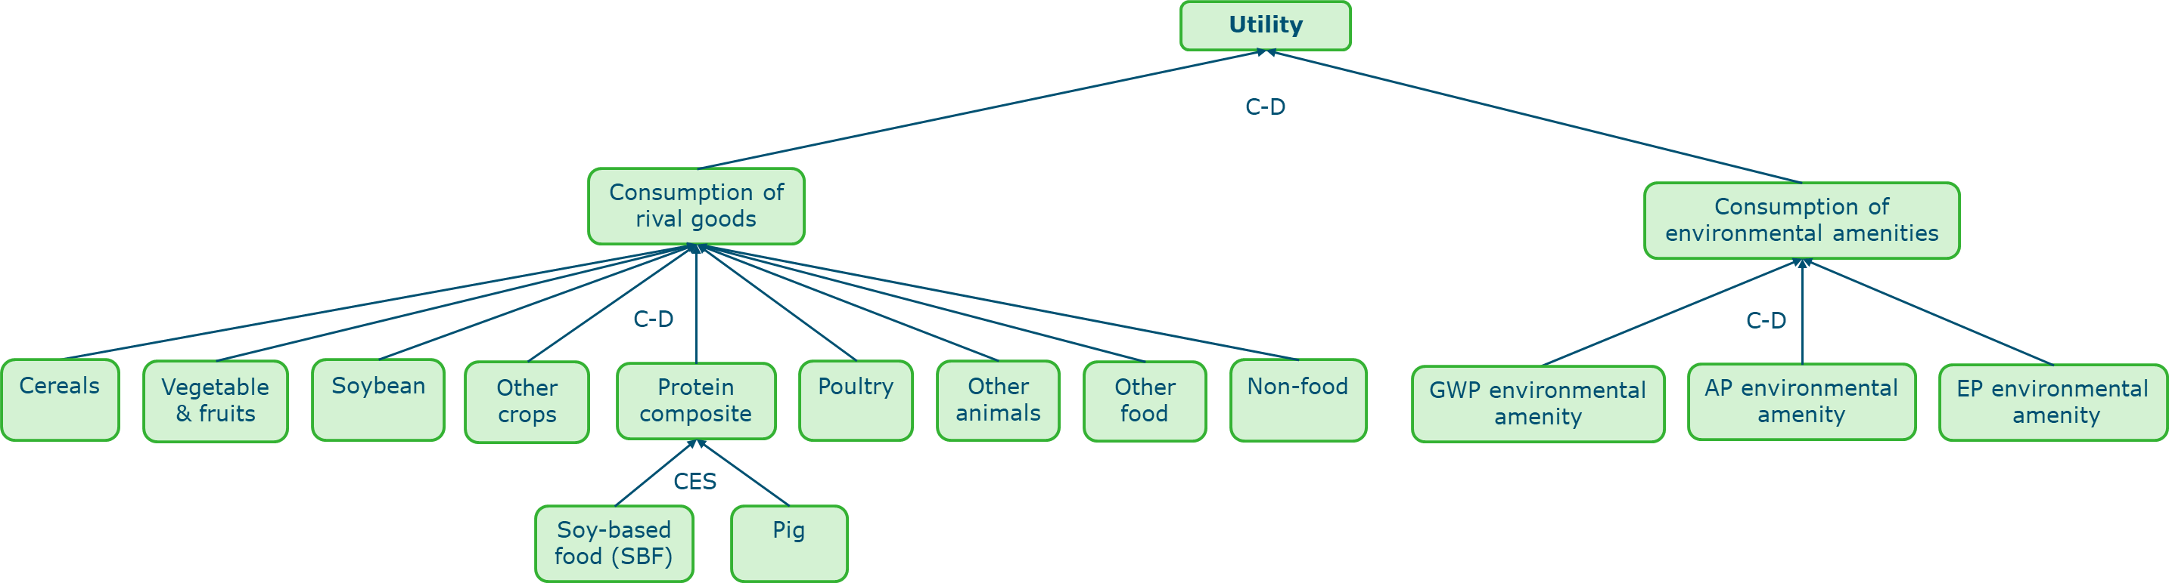
Utility function of the consumer in each region

Slide 28
GTAP database: sectoral aggregation
Aggregated sectors | GTAP original sectors
Cereals | “Paddy ricr (pdr)” , “Processed rice”, “Wheat (wht)”, and “Cereal grains nec (gro)” sectors
Vegetables & fruits | “Vegetables, fruits, nuts (v_f)” sector
Soybean | Split from “Oil Seeds (osd)” sector
Other crops | “Oil Seeds (osd)” sector after splitting out soybean; “Sugar cane, sugar beet (c_b)”, “Plant-based fibers (pfb)”, and “Crops nec (ocr)” sectors
Pig | Split from the original “Animal products nec (oap)” and “Meat products nec (omt)” sectors
Poultry | Split from the original “Animal products nec (oap)” and “Meat products nec (omt)” sectors
Other animals | “Animal products nec (oap)” and “Meat products nec (omt)” sectors after splitting out pig and poultry; “Cattle, sheep, goats, horses (ctl)”, “Meat: cattle, sheep, goats, horses (cmt)”, “Raw milk (rmk)”, “Wool, silk-worm cocoons (wol)”, and “Dairy products (mil)” sectors
Compound feed | Split from the original “Food products nec (ofd)”
Soy-based food | Split from the original “Food products nec (ofd)”
Other food | “Food products nec (ofd)” after splitting out compound feed and soy food; “Vegetable oils and fats (vol)”, “Sugar (sgr)”, and “Beverages and Tobacco products (b_t)” sectors
Nitrogen fertiliser | Split from the original “Manufacture of chemicals and chemical products (chm)” sector
Phosphorus fertiliser | Split from the original “Manufacture of chemicals and chemical products (chm)” sector
Non-food | “Manufacture of chemicals and chemical products (chm)” sector after splitting out N fertiliser and P₂O₅ fertiliser; “Forestry (frs)”, “Fishing (fsh)”, “Coal (coa)”, “Oil (oil)”, “Gas (gas)”, “Minerals nec (oxt)”, “Petroleum, coal products (p_c)”, “Electricity (ely)”, “Gas manufacture, distribution (gdt)”, “Textiles （tex)”, “Wearing apparel (wap)”, “Leather products (lea)”, “Wood products (lum)”, “Paper products, publishing (ppp)”, “Manufacture of pharmaceuticals, medicinal chemical and botanical products (bph)”, “Manufacture of rubber and plastics products (rpp)”, “Mineral products nec (nmm)”, “Ferrous metal (i_s)”, “Metal nec (nfm)”, “Metal products (fmp)”, Electronic equipment (ele)”, “Manufacture of electrical equipment (eeq)”, “Manufacture of machinery and equipment n.e.c. (ome)”, “Motor vehicles and parts (mvh)”, “Transport equipment nec (otn)”, “Manufactures nec (omf)”, “Water (wtr)”, “Construction (cns)”, “Wholesale and retail trade; repair of motor vehicles and motorcycles (trd)”, “Accommodation, Food and service activities (afs)”, “Land transport and transport via pipelines (otp)”, “Warehousing and support activities (whs)”, “Sea transport (wtp)”, “Air transport (atp)”, “Communication (cmn)”, “Financial services nec (ofi)”, “Insurance (ins)”, “Real estate activities (rsa)”, “Other Business Services nec (obs)”, “Recreation & other services (ros)”, “Other Services (Government) (osg)”, “Education (edu)”, “Human health and social work (hht)”, “Dwellings: ownership of dwellings (imputed rents of houses occupied by owners) (dwe)” sectors

Slide 29
Sensitivity analysis
Environmental willingness to pay for improving one type of environmental quality:
1/3 for GWP, 1/3 for AP, and 1/3 for EP (current)
Only improving GWP/AP/EP environmental quality: 1,0,0 / 0,1,0 / 0,0,1
Equal environmental willingness to pay in both regions:
0.01 for China and 0.02 for MFIP (current)
The environmental willingness to pay in both regions are equal : 0.02 for China and MFIP
Substitution elasticity between pork and soy-based food:
0.5 (current) → change from 0.5 to 1.5
Technology replacement ratio: 0.5 (current) → change from 0 to 1
Emission reduction target:
0.03 for GWP, 0.03 for AP, and 0.03 for EP (current)
→ Only reducing GWP: 0.03 for GWP, 0 for AP, and 0 for EP
→ Only reducing AP: 0 for GWP, 0.03 for AP, and 0 for EP
→ Only reducing EP: 0 for GWP, 0 for AP, and 0.03 for EP
29

